Slide 1

Introduction to HTTP
Dr. Muhammad Habib

Slide 2
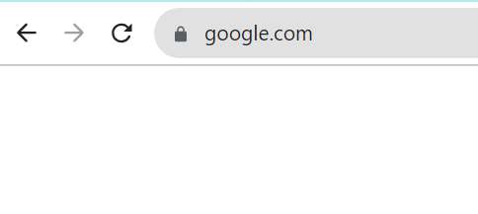
Introduction to HTTP
Have you ever noticed the lock icon beside the URL in your web browser?
This means the HTTPS, a secure version of HTTP is being used.
HTTP is a core operational protocol of the world wide web.
It is what enables your web browser to communicate with a webserver that hosts a website.

Slide 3
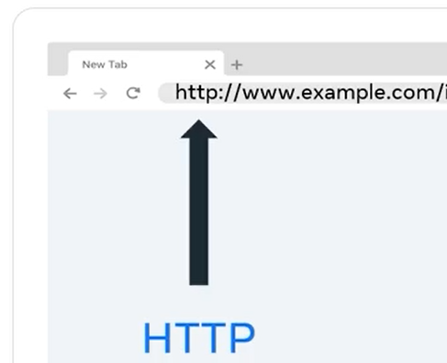
Introduction to HTTP
HTTP is the communication protocol you use whenever you browse the web.
HTTP stands for Hyper text Transfer Protocol is a protocol used for transferring web resources such as HTML documents, images, styles, and other files.

Slide 4
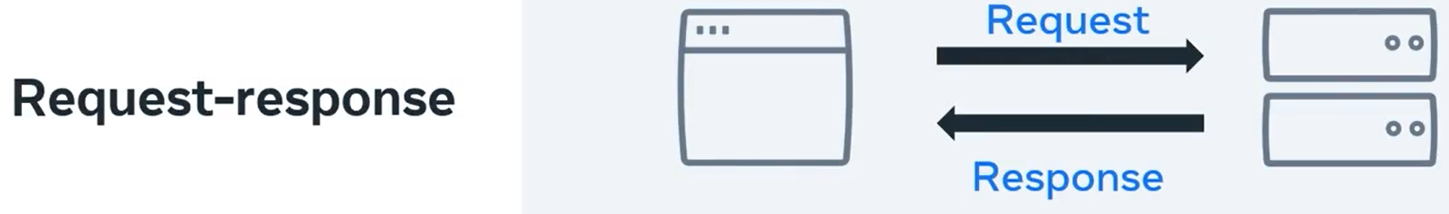
Introduction to HTTP
HTTP is a request response based protocol.
A web browser or client sends an HTTP request to a server, and the webserver sends the HTTP response back to the browser.
Next, let's start exploring the makeup of an HTTP request.

Slide 5
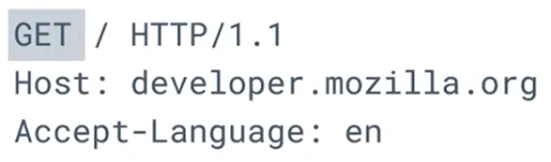
HTTP Request
An HTTP requests consists of a
method, [ Get ]
path, [ / ]
version, [ HTTP/1.1 ], and
headers [Host: developer.mozila.org Accept-Language: en ]

Slide 6
HTTP Method
The HTTP method describes the type of action that the client was to perform.
The primary or the most commonly used HTTP methods are
GET,
POST,
PUT and
DELETE

Slide 7
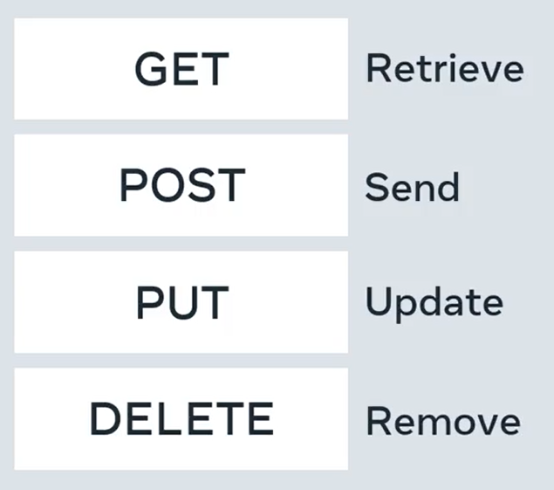
HTTP Method
The GET method is used to retrieve information from the given server.
The POST request is used to send data to the server.
The PUT method updates whatever currently exist on the website with something else and the
DELETE method removes the resource.

Slide 8
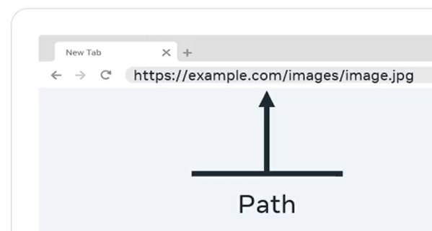
HTTP Method
The path is the representation of where the resource is stored on the webserver.
For example, if you requested an image at https://example.com/images/image.jpg

Slide 9
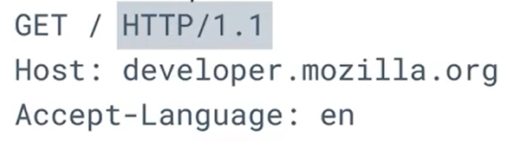
HTTP Version
There are multiple versions of the HTTP protocol.
I won't explore these right now, but I want you to be aware that Version 1.1 and 2.0 are the most used.

Slide 10
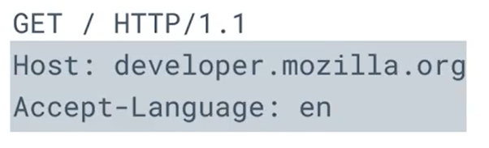
HTTP Headers
Headers contain additional information about the request, and the client that is making the request.
For certain requests methods, the requests will also contain a body of content that the client is sending.

Slide 11
HTTP Response
Now, let's cover some details about the makeup of an HTTP response.
HTTP responses follow a format similar to the request format.
Following the header, the response will optionally contain a message body consisting of the response contents such as the HTML document, the image file, and so forth.

Slide 12
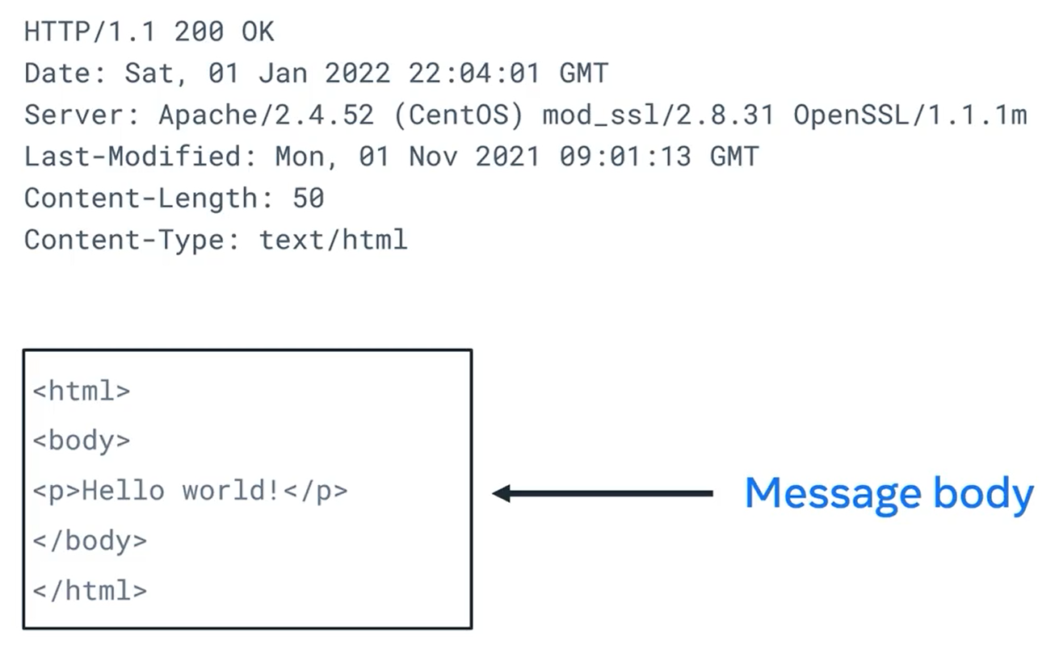
HTTP Response

Slide 13
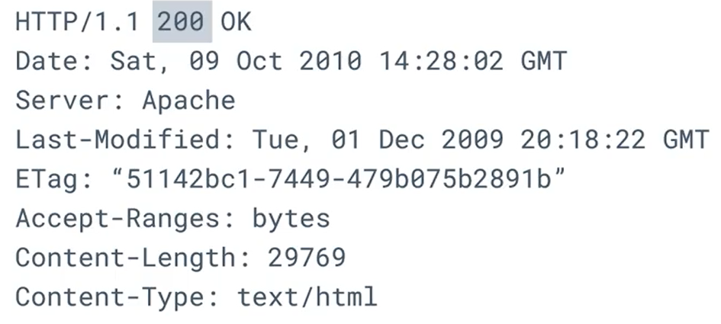
HTTP Status Codes
HTTP status codes indicate if the HTTP requests successfully completed.
The code values are in the range of a 100-599 and a grouped by purpose.

Slide 14
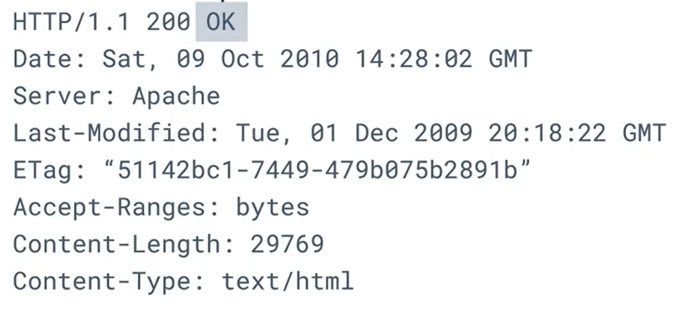
HTTP Status Message
The status message is a text representation of the status code.

Slide 15
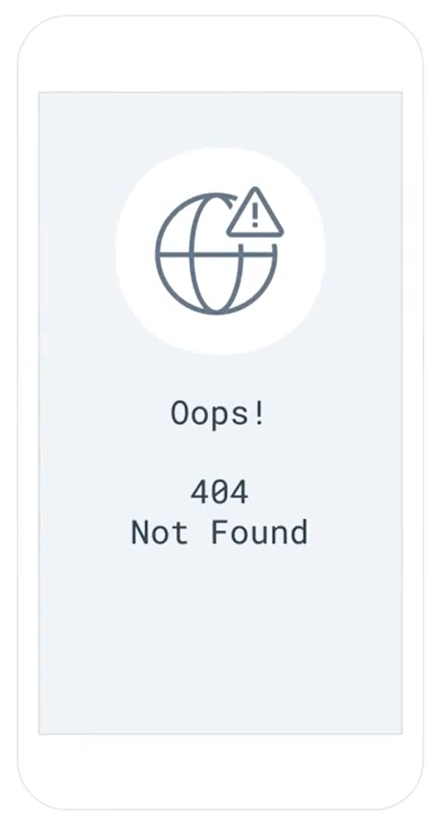
HTTP Status Codes
During your web browsing, have you ever encountered pages that display 404 error not found or 500 errors?
Server is not responding?
These are HTTP status codes.

Slide 16
Groups of Status Codes
There are five (05) groups of status codes.
They're grouped by the first digit of the error number.
Informational is grouped from 100-199.
Successful responses are grouped from 200-299.
Redirection message are from 300-399.
Client error responses ranged from 400-499 and
server error responses are from 500- 599.

Slide 17
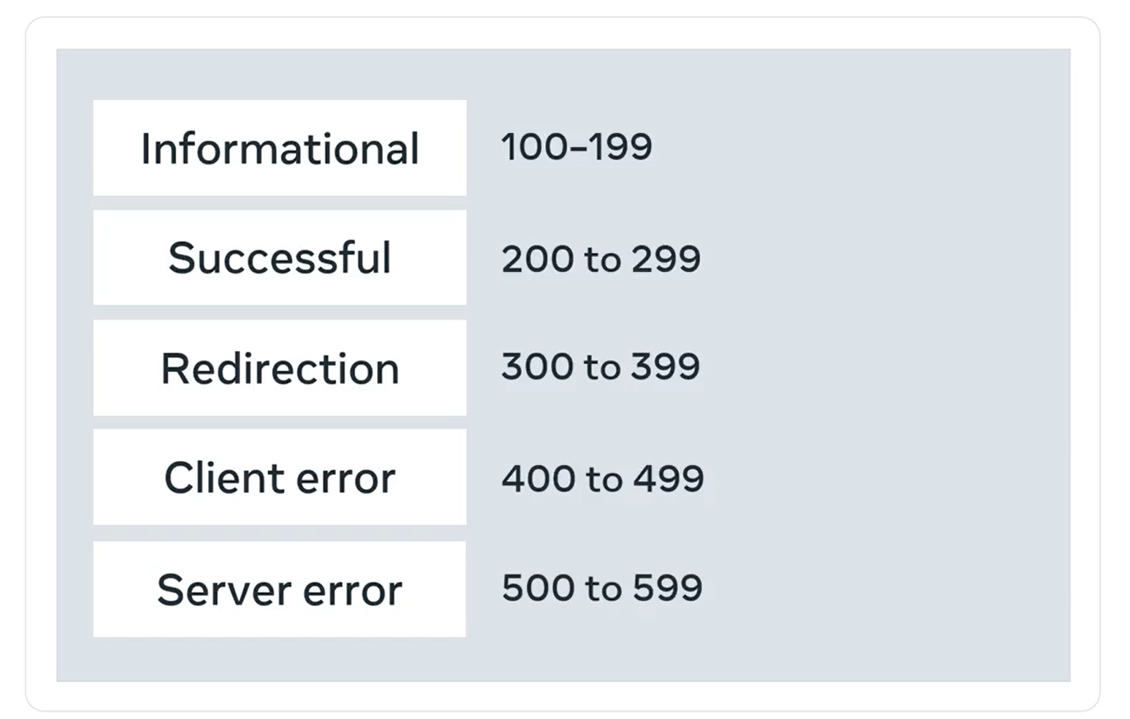
Groups of Status Codes

Slide 18

Informational Responses (100-199)
Information responses are provisional responses sent by the server.
These responses are interim before the actual response.
The most common inflammation response is 100 Continue, which indicates that the web client should continue to request or ignore the response if the request is already finished.

Slide 19

Successful Responses (200-299)
Successful responses indicate that the request was successfully processed by the web server, with the most common success response being 200 Ok.
You're receiving these responses every day when you receive content successfully from a website.

Slide 20
Successful Responses (200-299)
The meaning of Ok depends on the HTTP method.
If the method is GET, it means that the resource is found and is included in the body of the HTTP response.
If it's POST, it means that the resource was successfully transmitted to the webserver.
If it's PUT, the resource was successfully transmitted to the webserver.
Finally, if the method is DELETE, it means the resource was deleted.

Slide 21
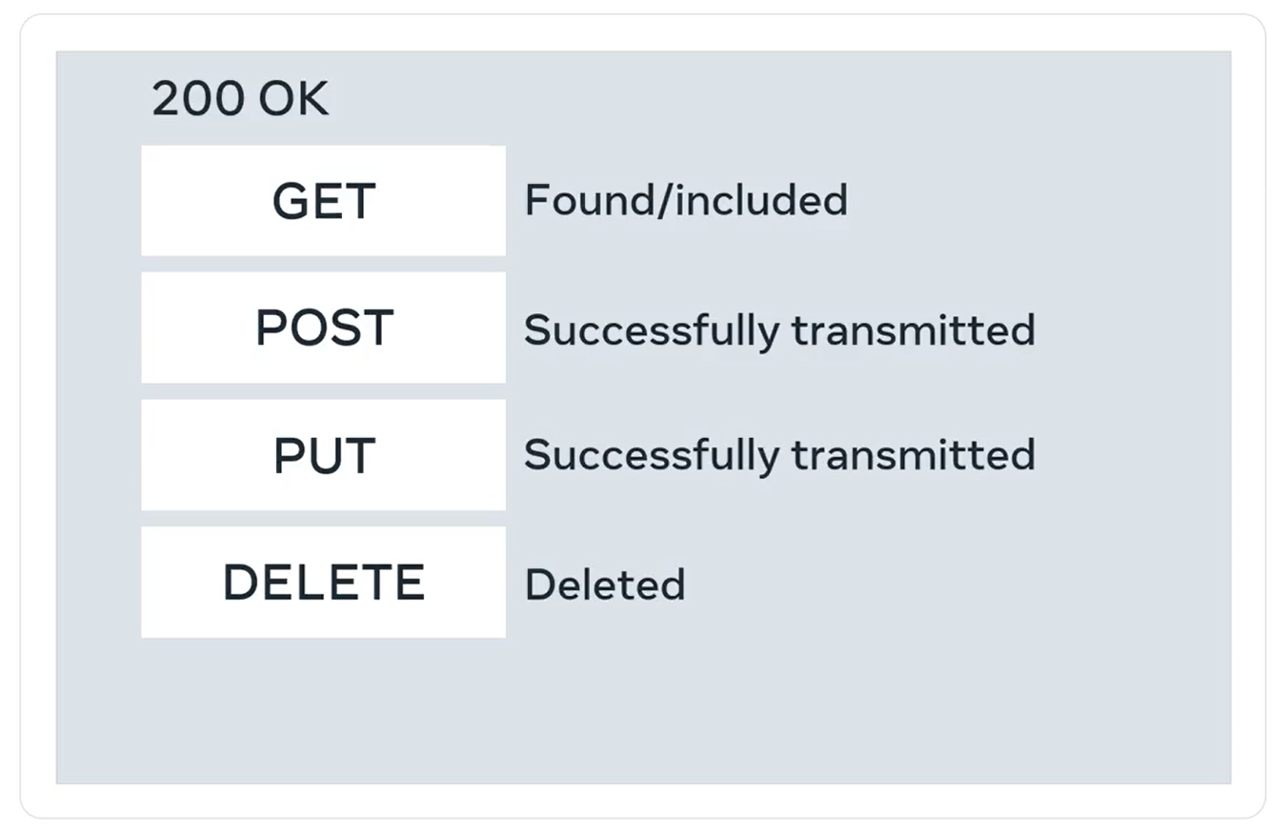
Successful Responses (200-299)

Slide 22

Redirection Responses (300-399)
Redirection responses indicate to the web client that the requested resource has been moved to a different path.
The most common response codes used are 301 Moved Permanently and 302 Found.

Slide 23
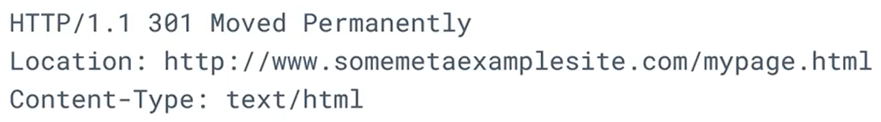
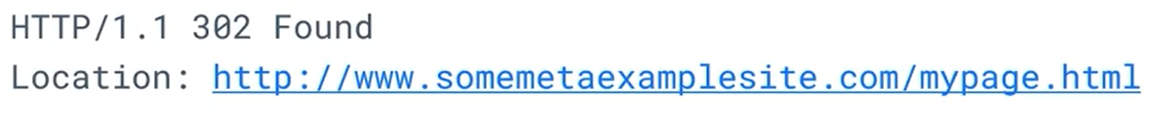
Redirection Responses (300-399)
The difference between the redirection messages 301 and 302 is that 302 indicates a temporary redirection. The resource has been temporarily moved.

Slide 24
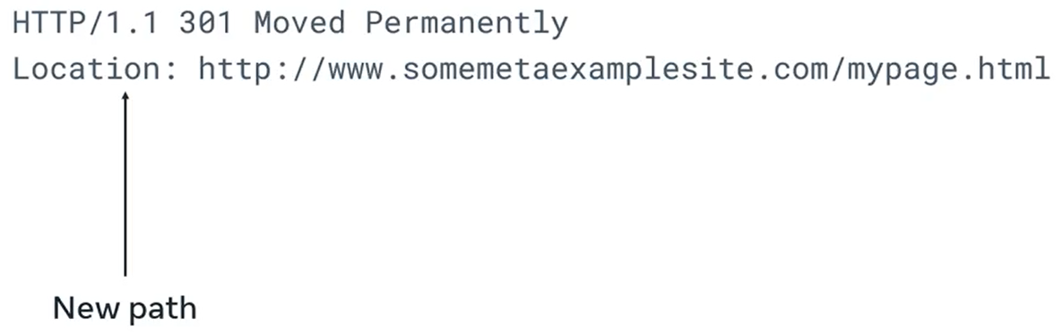
Redirection Responses (300-399)
When web browsers receive these responses, they will automatically submit the request for the resource at the new path.

Slide 25
Client Error Responses (400-499)
Client error responses indicate that the requests contained bad syntax or content and cannot be processed by the webserver.
The most common codes used are, 400 is used where the web browser or client submitted bad data to the webserver.
401 is used to indicate that the user must log into an account before the request can be processed.

Slide 26
Client Error Responses (400-499)
403 is used to indicate the request was valid, but that the webserver is refusing to process it. This is often used to indicate that a user does not have sufficient permissions to execute an action in a web application.
404 is used to indicate that the request resource was not found on the webserver.

Slide 27

Server Error Responses (500-599)
Server error responses indicate that a failure occurred on the webserver while trying to process the request.
The most common code used is 500 Internal Server Error, which is a generic error status indicating that the server fail to process the request.

Slide 28
HTTPS
Now, have you ever bought something online and needed to enter your credit card information?
You wouldn't want someone else to get this information from the HTTP request.
This is where HTTPS is involved.
HTTPS is the secure version of HTTP.

Slide 29
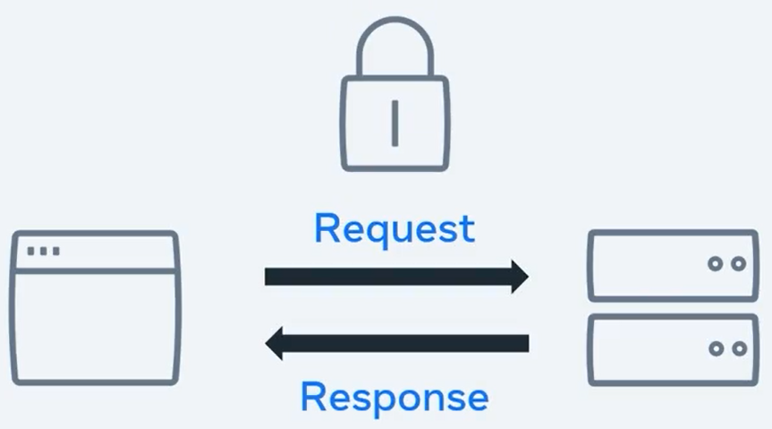
HTTPS
It is used for secure communication between two computers so that nobody else can see the information being sent and received.
It does this by using something called encryption.

Slide 30
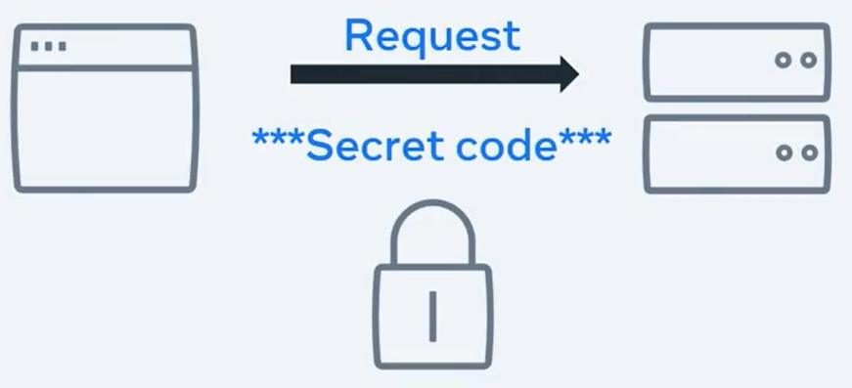
HTTPS
Like an HTTP, the requests and responses still behave in the same way and have the same content.
The big difference is before the content is sent, it is turned into a secret code.
Only the other computer can turn the secret code back into its original content.

Slide 31
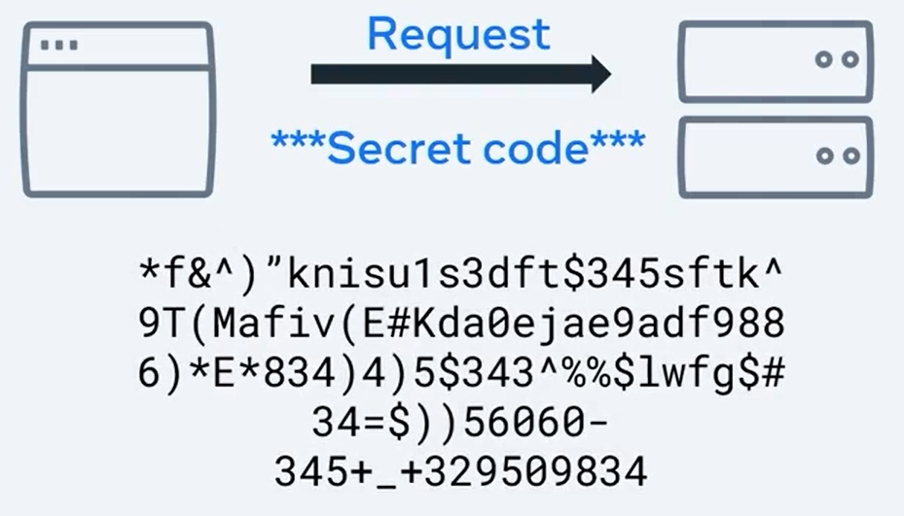
HTTPS
If someone else was to look at the code, it wouldn't be understandable.

Slide 32
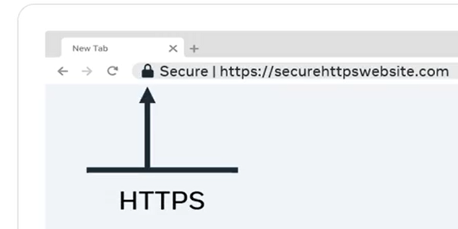
HTTPS
You use HTTPS every day.
This is the lock icon you see beside the URL in your web browser.

Slide 33
Summary
Firstly, it is a protocol used by web clients and web servers.
It works to transfer web resources such as HTML files and as the foundation of any data exchanges on the web.
Also, remember that by using HTTPS, we send the information securely.
Requests are sent by the client, usually a web browser, and the server replies with responses which may be the return of an image or an HTML page.

Slide 34
Summary
HTTP requests have a syntax that includes method, path, versions, and headers.
HTTP responses follow a similar format to the request.
An HTTP status codes indicate whether the HTTP requests successfully completed.
The status code is a three-digit number that corresponds with groups representing different types of results.

Slide 35
Summary
Now you know how the HTTP protocol request and response cycle works.
You know about its methods and the elements that make up an HTTP request.

Slide 36
Additional Resources
Learn more Here is a list of resources that may be helpful as you continue your learning journey.
HTTP Overview (Mozilla)
https://developer.mozilla.org/en-US/docs/Web/HTTP/Overview
Introduction to Networking by Dr.Charles R Severance
https://www.amazon.com/Introduction-Networking-How-Internet-Works/dp/1511654945/
Chrome Developer Tools Overview (Google)
https://developer.chrome.com/docs/devtools/overview/
Firefox Developer Tools User Docs (Mozilla)
https://firefox-source-docs.mozilla.org/devtools-user/index.html
Getting Started with Visual Studio Code (Microsoft)
https://code.visualstudio.com/docs

Slide 37
Thank You

